Slide 1
Exercise-8.5

Slide 2
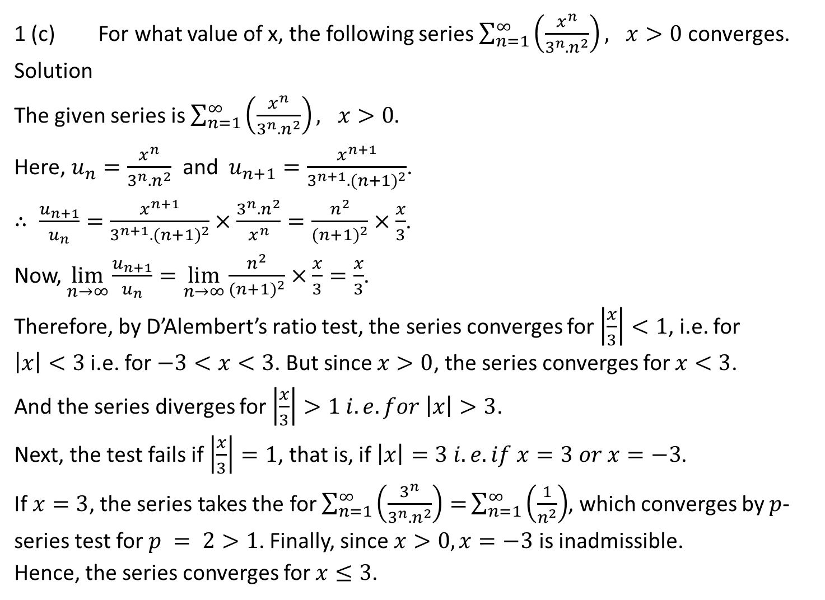
1 (c) For what value of x, the following series $\sum_{n=1}^{∞}{\left(\frac{x^{n}}{3^{n}.n^{2}}\right), x>0}$ converges.
Solution
The given series is $\sum_{n=1}^{∞}{\left(\frac{x^{n}}{3^{n}.n^{2}}\right), x>0}$.
Here, $u_{n}=\frac{x^{n}}{3^{n}.n^{2}}$ and $u_{n+1}=\frac{x^{n+1}}{3^{n+1}.{(n+1)}^{2}}$.
$∴ \frac{u_{n+1}}{u_{n}}=\frac{x^{n+1}}{3^{n+1}.{(n+1)}^{2}}×\frac{3^{n}.n^{2}}{x^{n}}=\frac{n^{2}}{{(n+1)}^{2}}×\frac{x}{3}$.
Now, $\lim_{n→∞}{\frac{u_{n+1}}{u_{n}}=\lim_{n→∞}{\frac{n^{2}}{{(n+1)}^{2}}×\frac{x}{3}=\frac{x}{3}}}$.
Therefore, by D’Alembert’s ratio test, the series converges for $\left|\frac{x}{3}\right|<1$, i.e. for $\left|x\right|<3$ i.e. for $−3<x<3$. But since $x>0$, the series converges for $x<3$.
And the series diverges for $\left|\frac{x}{3}\right|>1 i.e. for \left|x\right|>3$.
Next, the test fails if $\left|\frac{x}{3}\right|=1$, that is, if $\left|x\right|=3 i.e. if x=3 or x=−3$.
If $x=3$, the series takes the for $\sum_{n=1}^{∞}{\left(\frac{3^{n}}{3^{n}.n^{2}}\right)=}\sum_{n=1}^{∞}{\left(\frac{1}{n^{2}}\right)}$, which converges by $p$-series test for $p = 2>1$. Finally, since $x>0, x=−3$ is inadmissible.
Hence, the series converges for $x≤3$.

Slide 3
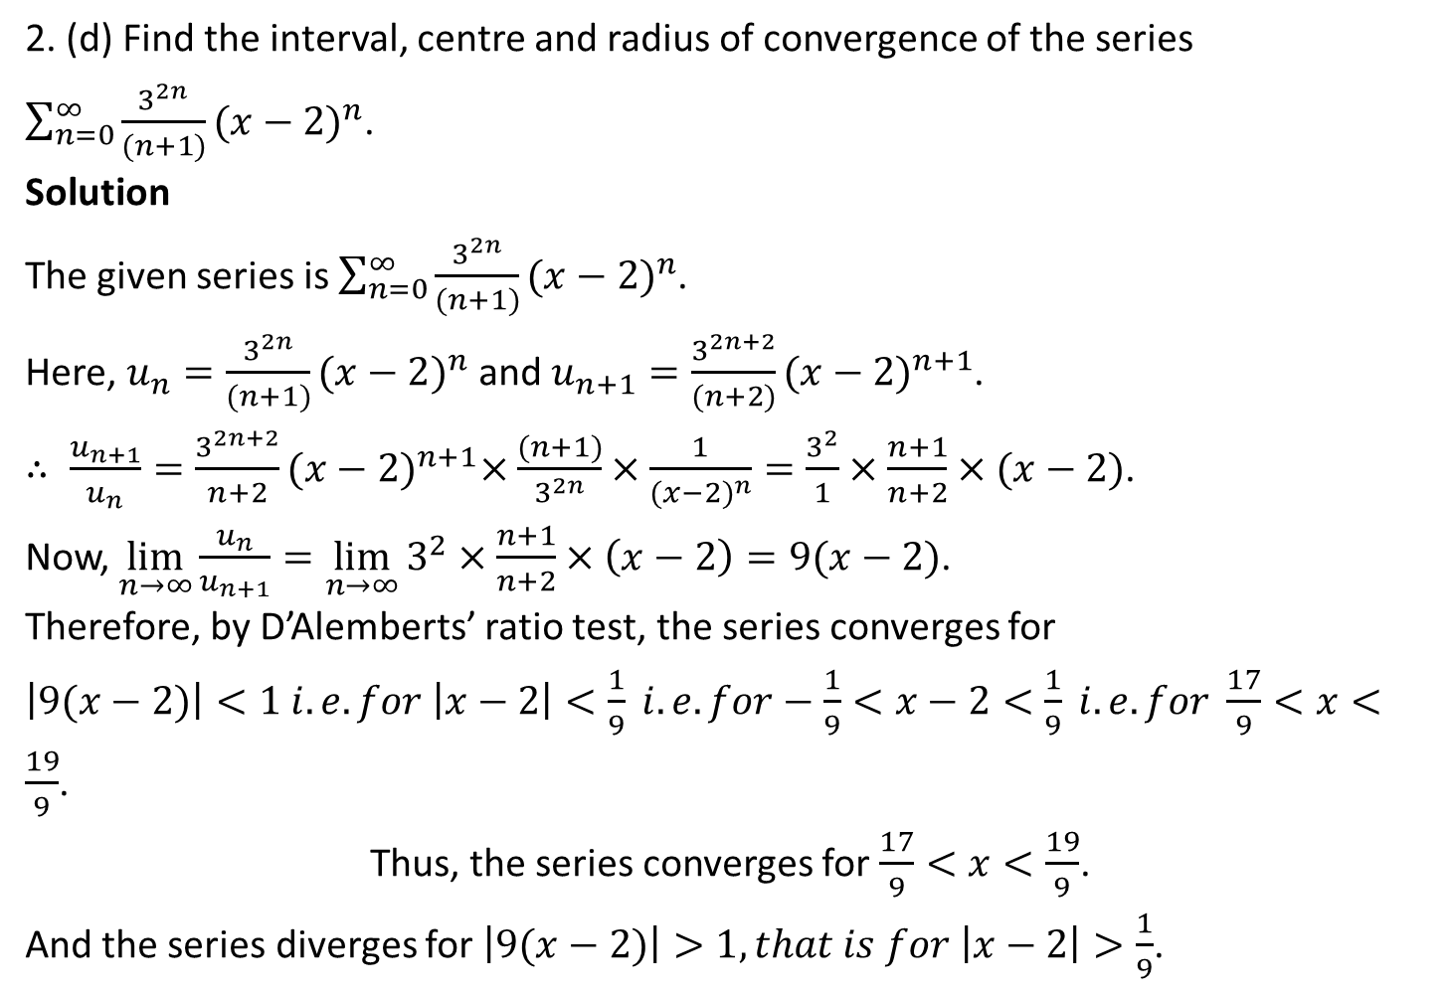
2. (d) Find the interval, centre and radius of convergence of the series $\sum_{n=0}^{∞}{\frac{3^{2n}}{(n+1)}{(x−2)}^{n}}$.
Solution
The given series is $\sum_{n=0}^{∞}{\frac{3^{2n}}{(n+1)}{(x−2)}^{n}}$.
Here, $u_{n}=\frac{3^{2n}}{(n+1)}{(x−2)}^{n}$ and $u_{n+1}=\frac{3^{2n+2}}{(n+2)}{(x−2)}^{n+1}$.
$∴ \frac{u_{n+1}}{u_{n}}=\frac{3^{2n+2}}{n+2}{(x−2)}^{n+1}×\frac{(n+1)}{3^{2n}}×\frac{1}{{(x−2)}^{n}}=\frac{3^{2}}{1}×\frac{n+1}{n+2}×(x−2)$.
Now, $\lim_{n→∞}{\frac{u_{n}}{u_{n+1}}=\lim_{n→∞}{3^{2}×\frac{n+1}{n+2}}×\left(x−2\right)=9(x−2)}$.
Therefore, by D’Alemberts’ ratio test, the series converges for
$\left|9(x−2)\right|<1 i.e. for \left|x−2\right|<\frac{1}{9} i.e. for−\frac{1}{9}<x−2<\frac{1}{9} i.e. for \frac{17}{9}<x<\frac{19}{9}$.
Thus, the series converges for $\frac{17}{9}<x<\frac{19}{9}$.
And the series diverges for $\left|9(x−2)\right|>1,that is for \left|x−2\right|>\frac{1}{9}$.

Slide 4
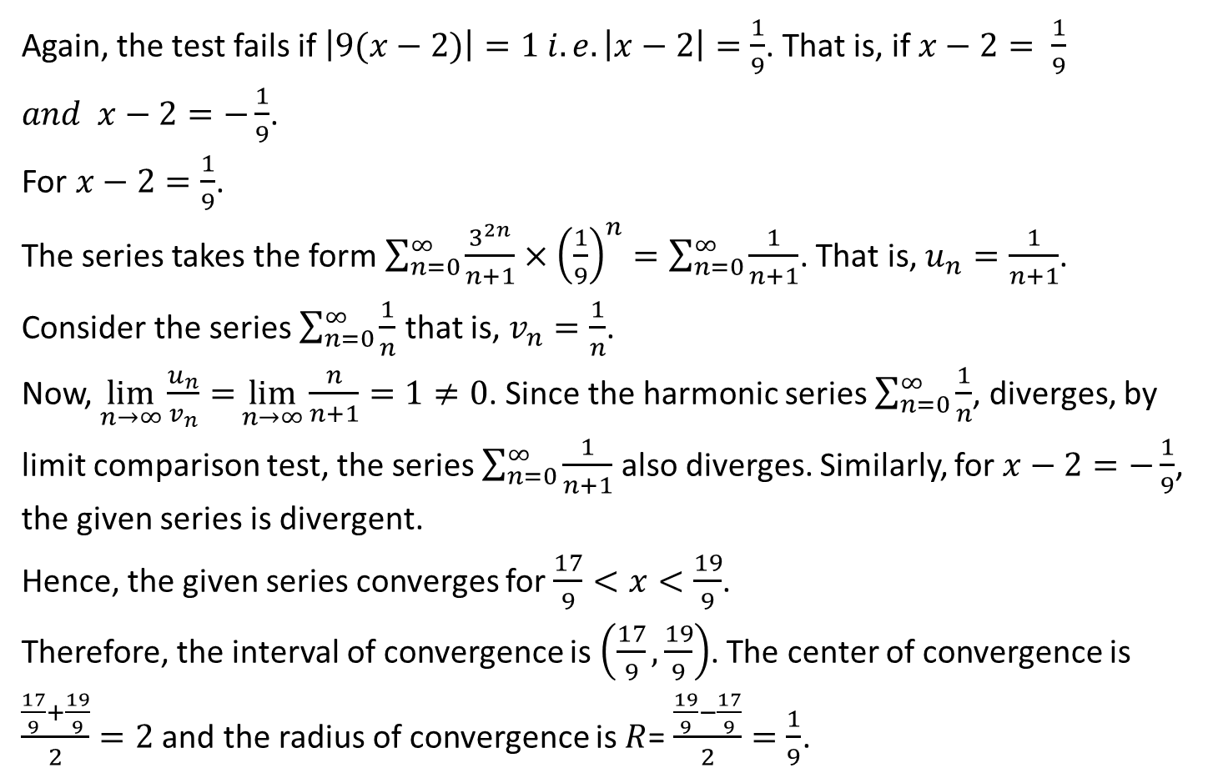
Again, the test fails if $\left|9(x−2)\right|=1 i.e. \left|x−2\right|=\frac{1}{9}$. That is, if $x−2= \frac{1}{9}$ $and x−2=−\frac{1}{9}$.
For $x−2=\frac{1}{9}$.
The series takes the form $\sum_{n=0}^{∞}{\frac{3^{2n}}{n+1}×{\left(\frac{1}{9}\right)}^{n}}=\sum_{n=0}^{∞}{\frac{1}{n+1}}$. That is, $u_{n}=\frac{1}{n+1}$. Consider the series $\sum_{n=0}^{∞}{\frac{1}{n}}$ that is, $v_{n}=\frac{1}{n}$.
Now, $\lim_{n→∞}{\frac{u_{n}}{v_{n}}=}\lim_{n→∞}{\frac{n}{n+1}=1≠0}$. Since the harmonic series $\sum_{n=0}^{∞}{\frac{1}{n}}$, diverges, by limit comparison test, the series $\sum_{n=0}^{∞}{\frac{1}{n+1}}$ also diverges. Similarly, for $x−2=−\frac{1}{9}$, the given series is divergent.
Hence, the given series converges for $\frac{17}{9}<x<\frac{19}{9}$.
Therefore, the interval of convergence is $\left(\frac{17}{9},\frac{19}{9}\right)$. The center of convergence is $\frac{\frac{17}{9}+\frac{19}{9}}{2}=2$ and the radius of convergence is $R$= $\frac{\frac{19}{9}−\frac{17}{9}}{2}=\frac{1}{9}$.

Slide 5
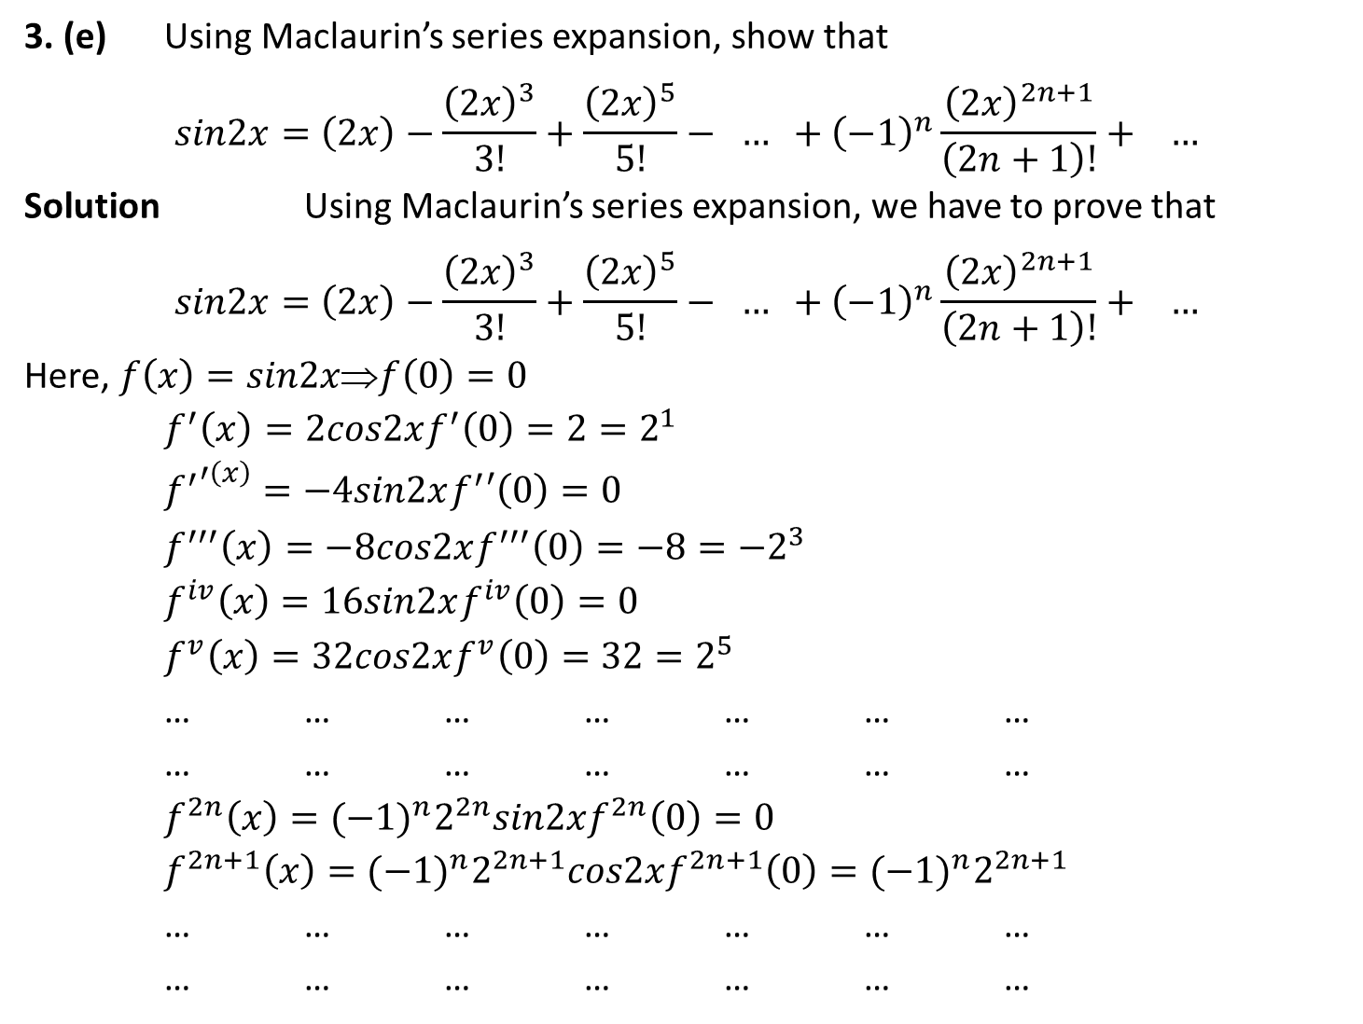
3. (e) Using Maclaurin’s series expansion, show that
$$sin2x=\left(2x\right)−\frac{{\left(2x\right)}^{3}}{3!}+\frac{{\left(2x\right)}^{5}}{5!}− … +{\left(−1\right)}^{n}\frac{{\left(2x\right)}^{2n+1}}{\left(2n+1\right)!}+ …$$
Solution Using Maclaurin’s series expansion, we have to prove that
$$sin2x=\left(2x\right)−\frac{{\left(2x\right)}^{3}}{3!}+\frac{{\left(2x\right)}^{5}}{5!}− … +{\left(−1\right)}^{n}\frac{{\left(2x\right)}^{2n+1}}{\left(2n+1\right)!}+ …$$
Here, $f\left(x\right)=sin2x⇒f\left(0\right)=0$
$f^{′}\left(x\right)=2cos2xf^{′}\left(0\right)=2=2^{1}$
${f^{′}}^{′\left(x\right)}=−4sin2xf^{′}′\left(0\right)=0$
$f^{′′′}\left(x\right)=−8cos2xf^{′′′}\left(0\right)=−8=−2^{3}$
$f^{iv}\left(x\right)=16sin2xf^{iv}\left(0\right)=0$
$f^{v}\left(x\right)=32cos2xf^{v}\left(0\right)=32=2^{5}$
… … … … … … …
… … … … … … …
$f^{2n}\left(x\right)={(−1)}^{n}2^{2n}sin2xf^{2n}\left(0\right)=0$
$f^{2n+1}\left(x\right)={(−1)}^{n}2^{2n+1}cos2xf^{2n+1}\left(0\right)={(−1)}^{n}2^{2n+1}$
… … … … … … …
… … … … … … …

Slide 6
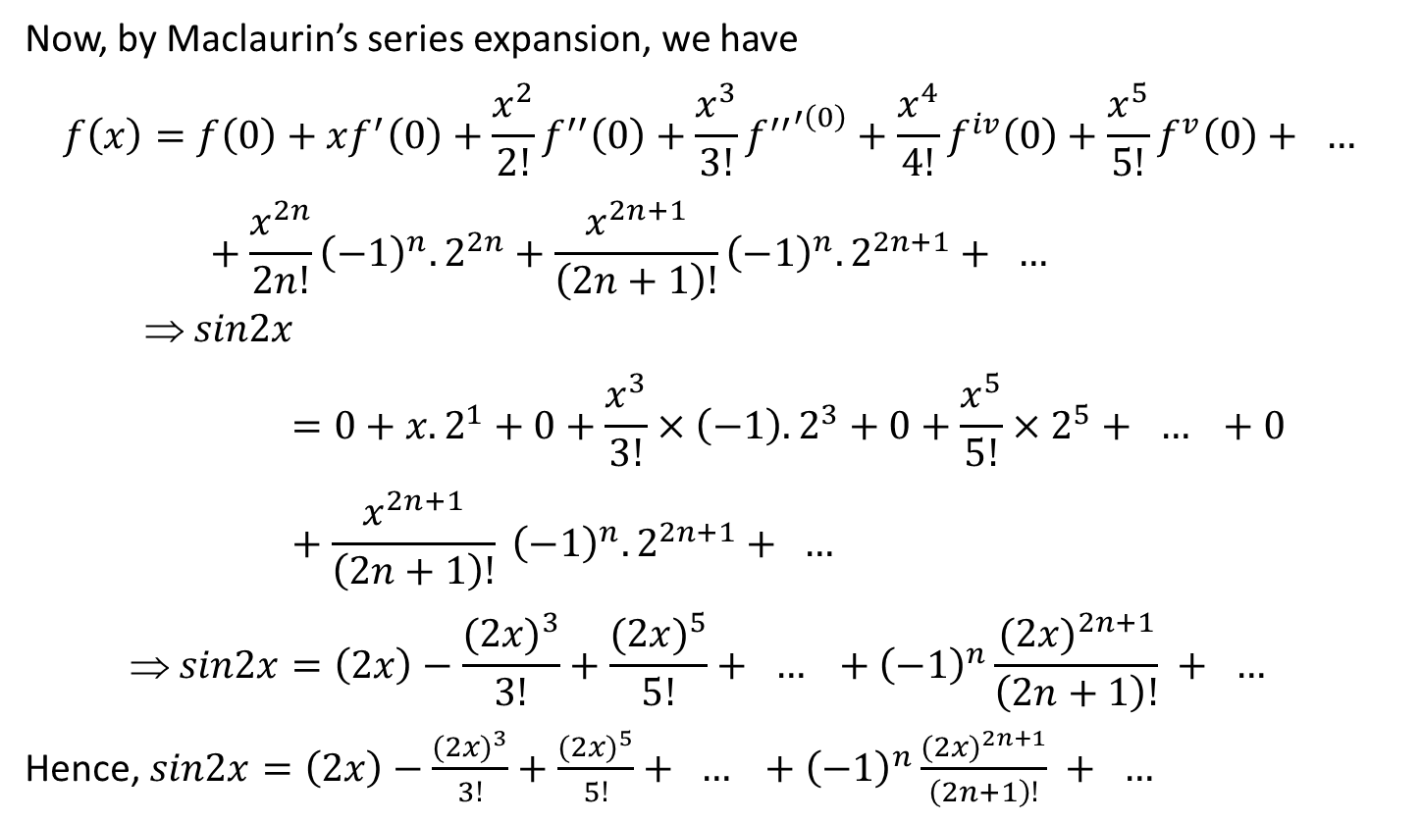
Now, by Maclaurin’s series expansion, we have
$$f\left(x\right)=f\left(0\right)+xf^{′}\left(0\right)+\frac{x^{2}}{2!}f^{′′}\left(0\right)+\frac{x^{3}}{3!}{f^{′′}}^{′\left(0\right)}+\frac{x^{4}}{4!}f^{iv}\left(0\right)+\frac{x^{5}}{5!}f^{v}\left(0\right)+ … +\frac{x^{2n}}{2n!}{\left(−1\right)}^{n}.2^{2n}+\frac{x^{2n+1}}{\left(2n+1\right)!}{\left(−1\right)}^{n}.2^{2n+1}+ …$$
$$ sin2x=0+x.2^{1}+0+\frac{x^{3}}{3!}×\left(−1\right).2^{3}+0+\frac{x^{5}}{5!}×2^{5}+ … +0+\frac{x^{2n+1}}{\left(2n+1\right)!} {\left(−1\right)}^{n}.2^{2n+1}+ …$$
$$ sin2x=\left(2x\right)−\frac{{(2x)}^{3}}{3!}+\frac{{(2x)}^{5}}{5!}+ … +{\left(−1\right)}^{n}\frac{{(2x)}^{2n+1}}{\left(2n+1\right)!} + …$$
Hence, $sin2x=\left(2x\right)−\frac{{(2x)}^{3}}{3!}+\frac{{(2x)}^{5}}{5!}+ … +{\left(−1\right)}^{n}\frac{{(2x)}^{2n+1}}{\left(2n+1\right)!} + …$

Slide 7
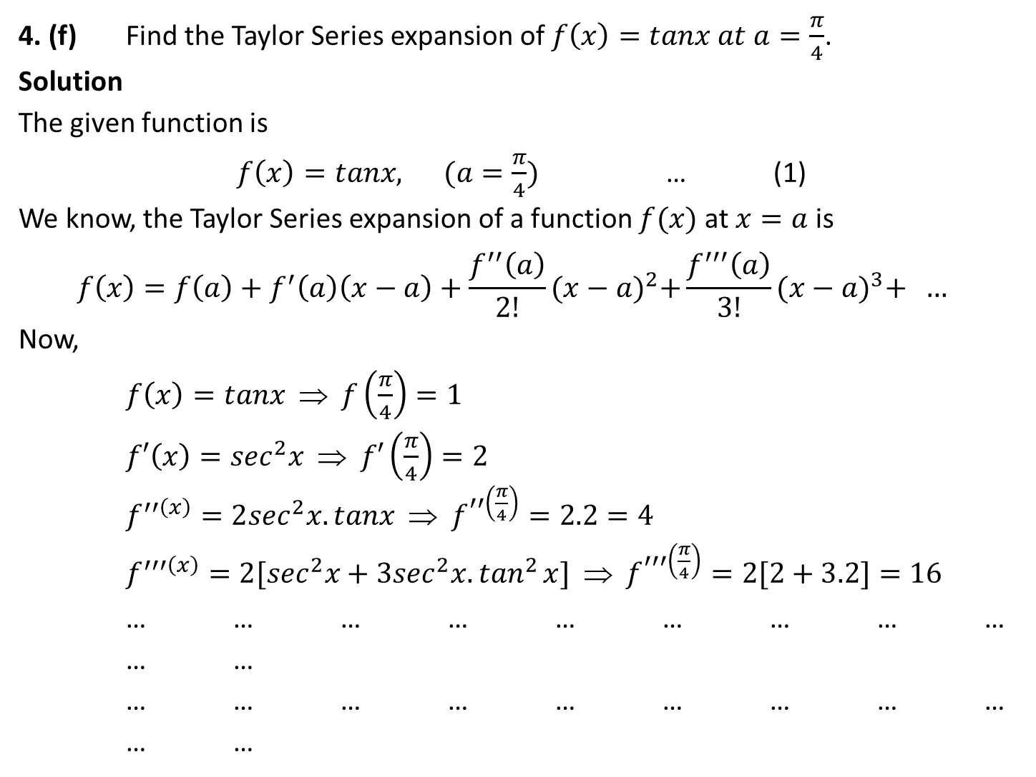
4. (f) Find the Taylor Series expansion of $f\left(x\right)=tanx at a=\frac{π}{4}$.
Solution
The given function is
$f\left(x\right)=tanx, (a=\frac{π}{4})$ … (1)
We know, the Taylor Series expansion of a function $f(x)$ at $x=a$ is
$$f\left(x\right)=f\left(a\right)+f^{′}\left(a\right)\left(x−a\right)+\frac{f^{′′}\left(a\right)}{2!}{(x−a)}^{2}+\frac{f^{′′′}\left(a\right)}{3!}{(x−a)}^{3}+ …$$
Now,
$f\left(x\right)=tanx ⇒ f\left(\frac{π}{4}\right)=1$
$f′\left(x\right)=\sec^{2}x ⇒ f′\left(\frac{π}{4}\right)=2$
$f^{′′\left(x\right)}=2\sec^{2}x.tanx ⇒ f^{′′\left(\frac{π}{4}\right)}=2.2=4$
$f^{′′′\left(x\right)}=2[\sec^{2}x+3\sec^{2}x{.tan}^{2}x] ⇒ f^{′′′\left(\frac{π}{4}\right)}=2[2+3.2]=16$
… … … … … … … … … … …
… … … … … … … … … … …

Slide 8
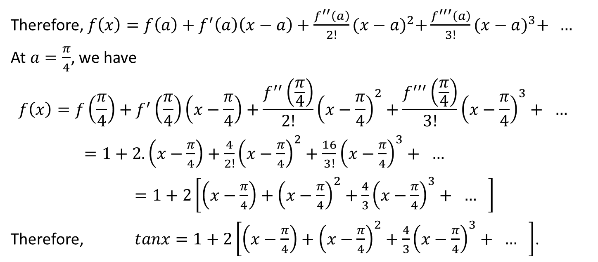
Therefore, $f\left(x\right)=f\left(a\right)+f^{′}\left(a\right)\left(x−a\right)+\frac{f^{′′}\left(a\right)}{2!}{(x−a)}^{2}+\frac{f^{′′′}\left(a\right)}{3!}{(x−a)}^{3}+ …$
At $a=\frac{π}{4}$, we have
$$f\left(x\right)=f\left(\frac{π}{4}\right)+f^{′}\left(\frac{π}{4}\right)\left(x−\frac{π}{4}\right)+\frac{f^{′′}\left(\frac{π}{4}\right)}{2!}{\left(x−\frac{π}{4}\right)}^{2}+\frac{f^{′′′}\left(\frac{π}{4}\right)}{3!}{\left(x−\frac{π}{4}\right)}^{3}+ …$$
$=1+2.\left(x−\frac{π}{4}\right)+\frac{4}{2!}{\left(x−\frac{π}{4}\right)}^{2}+\frac{16}{3!}{\left(x−\frac{π}{4}\right)}^{3}+ …$
$=1+2\left[\left(x−\frac{π}{4}\right)+{\left(x−\frac{π}{4}\right)}^{2}+\frac{4}{3}{\left(x−\frac{π}{4}\right)}^{3}+ … \right]$
Therefore, $tanx=1+2\left[\left(x−\frac{π}{4}\right)+{\left(x−\frac{π}{4}\right)}^{2}+\frac{4}{3}{\left(x−\frac{π}{4}\right)}^{3}+ … \right]$.

Slide 9
The End

